Slide 1

The power of the 1% How just a few mediators keep society together
Tudor Andrei Marculesteanu, Roza Bracic, Marinde van Dijk, Aakash Pelapor Anandakrishnan

Slide 2





What is your drink preference?

Slide 3
Can the network reach consensus?

Slide 4
Can the network reach consensus?

Slide 5
Motivation
The Problem:
Modern societies are increasingly facing polarization and "echo chambers.”
Traditional social dynamics models assume agents are identical, which fails to capture real-world complexity.
The Questions:
How does individual personality (stubbornness, openness) affect group consensus?
Can a small number of "Mediators" prevent a society from fracturing?
The Goal:
To replicate the foundational Holme-Newman model.
To extend it with a Heterogeneous population.
Study the model dynamics with a Heterogeneous population.

Slide 6
Research Question(s)
Q1: Does introducing degrees of stubbornness that influence interactions between individuals (making the network heterogeneous) change the dynamics of the system?
Q2: Does introducing “mediators” that seek out disagreement change the dynamics of the system?
Does it reach consensus?
How long does it take to reach consensus?
What are the sizes of the different communities at consensus?

Slide 7
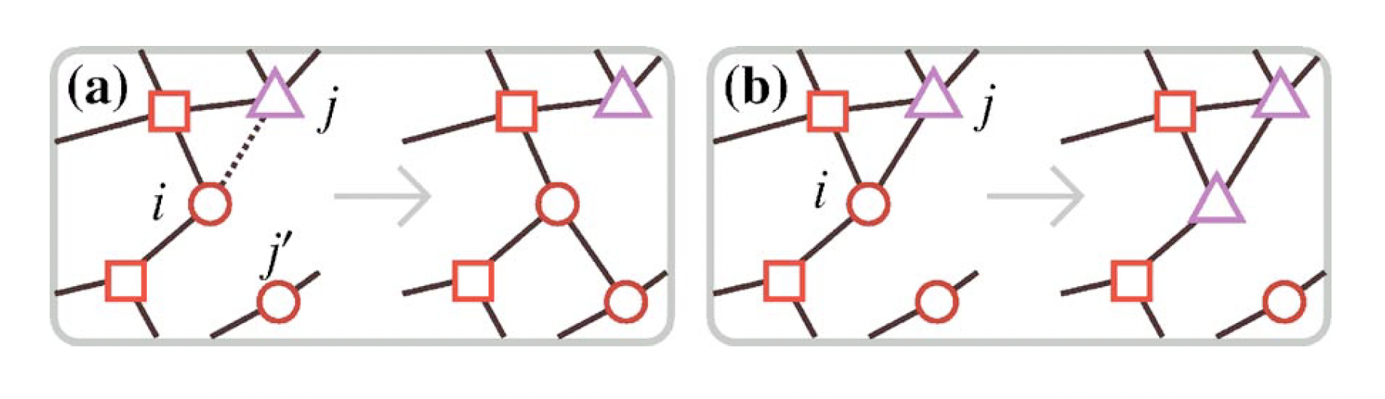
Base Model: Coevolution of opinions and connections
Holme & Newman (2006):
Nodes: Individuals, Edges = social connections, shape = opinion
At each step, pick a random individual i and a neighbour j (edge (i,j)
With probability φ: Rewire that edge to a random node with same opinion as i
With probability 1-φ: i adopts j's opinion
System evolves until no links connect disagreeing opinions
Outcome depends on φ: fragmentation vs global consensus
Source without alcohol symbols:
Holme, P., & Newman, M. E. (2006). Nonequilibrium phase transition in the coevolution of networks and opinions. Physical Review E—Statistical, Nonlinear, and Soft Matter Physics, 74(5), 056108.

Slide 8
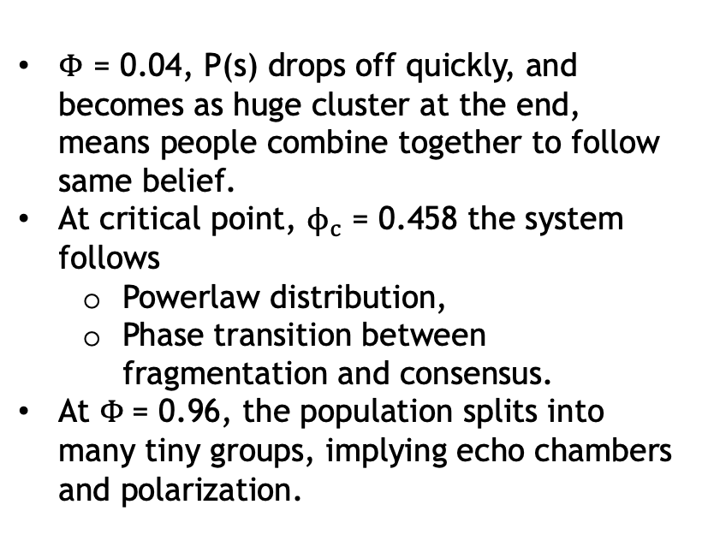
Community size distribution p(s)
System Behaviour
$Φ$ = 0.04, P(s) drops off quickly, and becomes as huge cluster at the end, means people combine together to follow same belief.
At critical point, $ϕ_{c}$ = 0.458 the system follows
Powerlaw distribution,
Phase transition between fragmentation and consensus.
At $Φ$= 0.96, the population splits into many tiny groups, implying echo chambers and polarization.

Slide 9
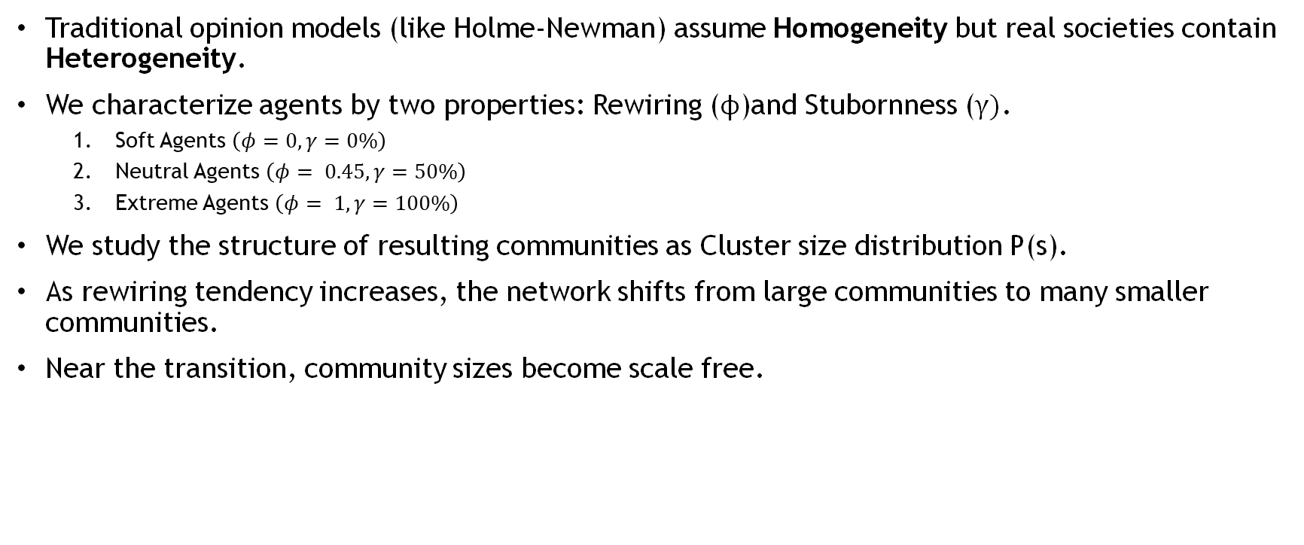
Heterogeneous Network
Traditional opinion models (like Holme-Newman) assume Homogeneity but real societies contain Heterogeneity.
We characterize agents by two properties: Rewiring ($ϕ$)and Stubornness ($γ)$.
Soft Agents $\left(φ=0,γ=0\%\right)$
Neutral Agents $\left(φ= 0.45,γ=50\%\right)$
Extreme Agents $\left(φ= 1,γ=100\%\right)$
We study the structure of resulting communities as Cluster size distribution P(s).
As rewiring tendency increases, the network shifts from large communities to many smaller communities.
Near the transition, community sizes become scale free.

Slide 10
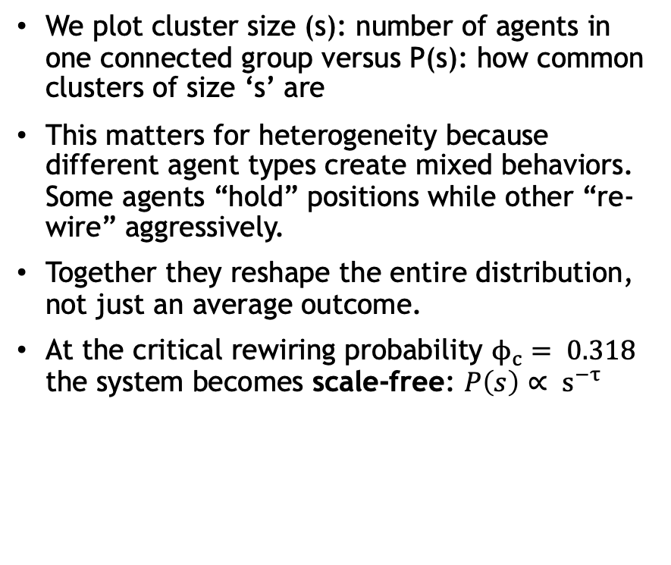
Power Law
We plot cluster size (s): number of agents in one connected group versus P(s): how common clusters of size ‘s’ are
This matters for heterogeneity because different agent types create mixed behaviors. Some agents “hold” positions while other “re-wire” aggressively.
Together they reshape the entire distribution, not just an average outcome.
At the critical rewiring probability $ϕ_{c}= 0.318$ the system becomes scale-free: $P\left(s\right)∝ s^{−τ}$

Slide 11
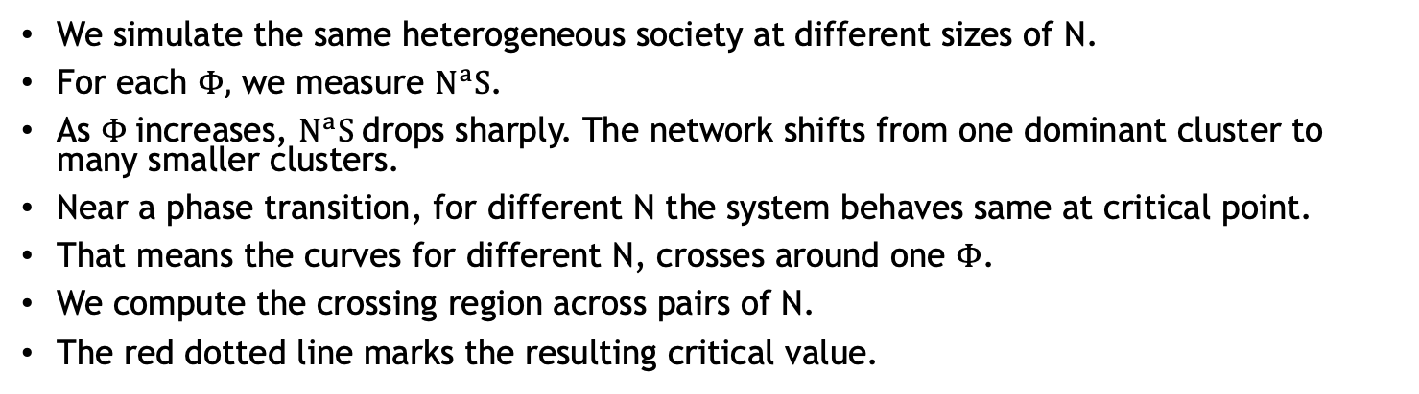
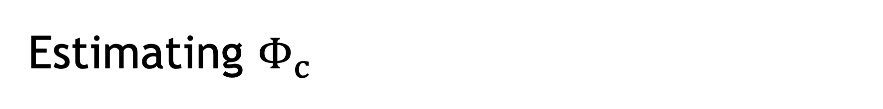
Estimating $Φ_{c}$
We simulate the same heterogeneous society at different sizes of N.
For each $Φ,$ we measure $N^{a}S$.
As $Φ$increases, $N^{a}S$drops sharply. The network shifts from one dominant cluster to many smaller clusters.
Near a phase transition, for different N the system behaves same at critical point.
That means the curves for different N, crosses around one $Φ$.
We compute the crossing region across pairs of N.
The red dotted line marks the resulting critical value.

Slide 12
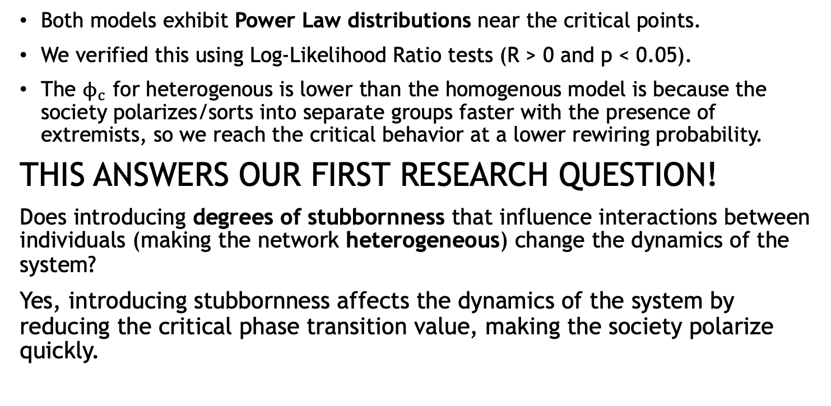
Cluster Size Distributions
Both models exhibit Power Law distributions near the critical points.
We verified this using Log-Likelihood Ratio tests (R > 0 and p < 0.05).
The $ϕ_{c}$ for heterogenous is lower than the homogenous model is because the society polarizes/sorts into separate groups faster with the presence of extremists, so we reach the critical behavior at a lower rewiring probability.
THIS ANSWERS OUR FIRST RESEARCH QUESTION!
Does introducing degrees of stubbornness that influence interactions between individuals (making the network heterogeneous) change the dynamics of the system?
Yes, introducing stubbornness affects the dynamics of the system by reducing the critical phase transition value, making the society polarize quickly.

Slide 13
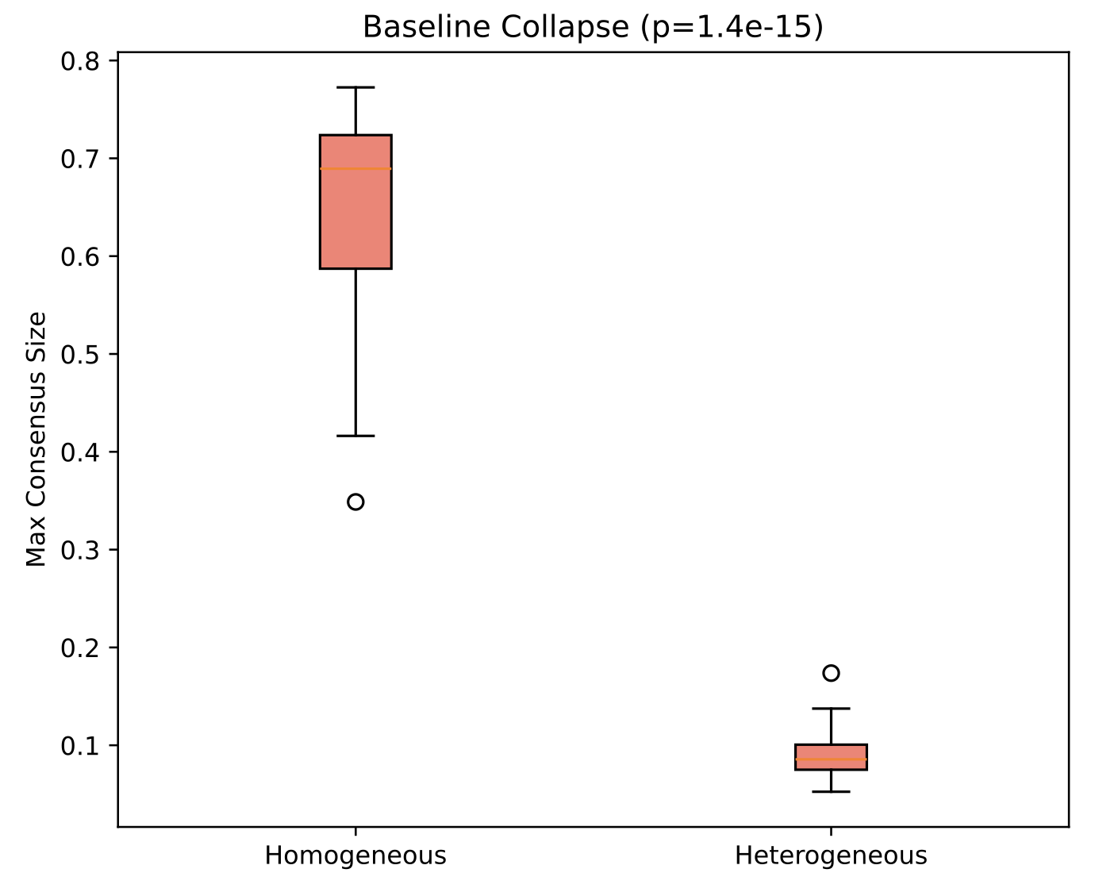
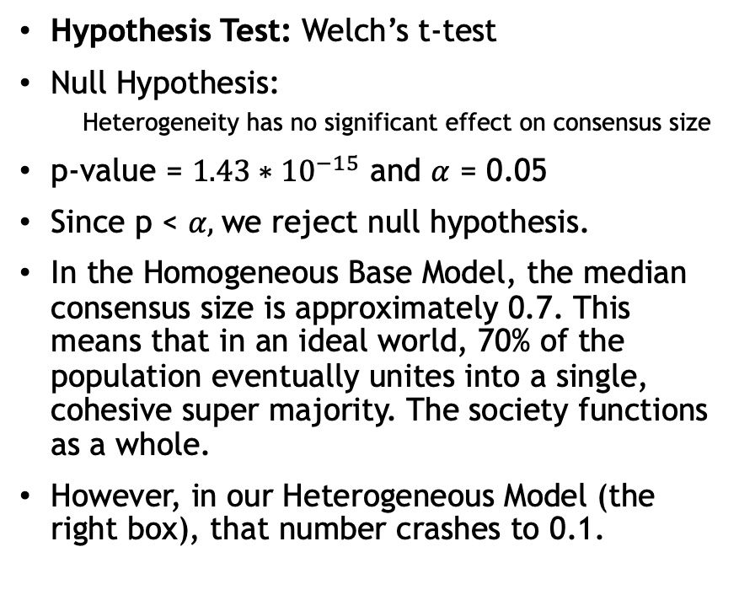
Statistical Analysis
Hypothesis Test: Welch’s t-test
Null Hypothesis:
Heterogeneity has no significant effect on consensus size
p-value = ${1.43∗10}^{−15}$ and $α$ = 0.05
Since p < $α,$we reject null hypothesis.
In the Homogeneous Base Model, the median consensus size is approximately 0.7. This means that in an ideal world, 70% of the population eventually unites into a single, cohesive super majority. The society functions as a whole.
However, in our Heterogeneous Model (the right box), that number crashes to 0.1.

Slide 14

Q2: Adding Mediators
4th agent type
Φ value: 0.45, stubbornness: 0
Key difference: reconnect to holders of opposite beliefs
Idea: bridge the gap between groups of different beliefs
Hypothesis: increase in mediator population -> increase in total population interconnectivity

Slide 15
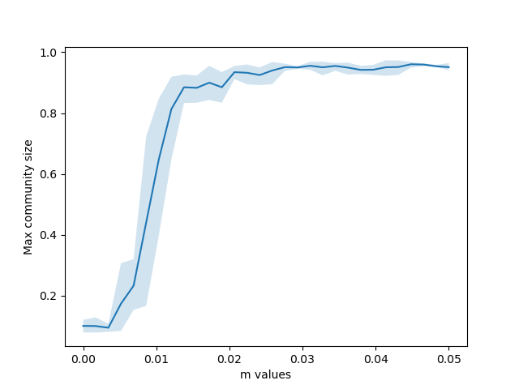
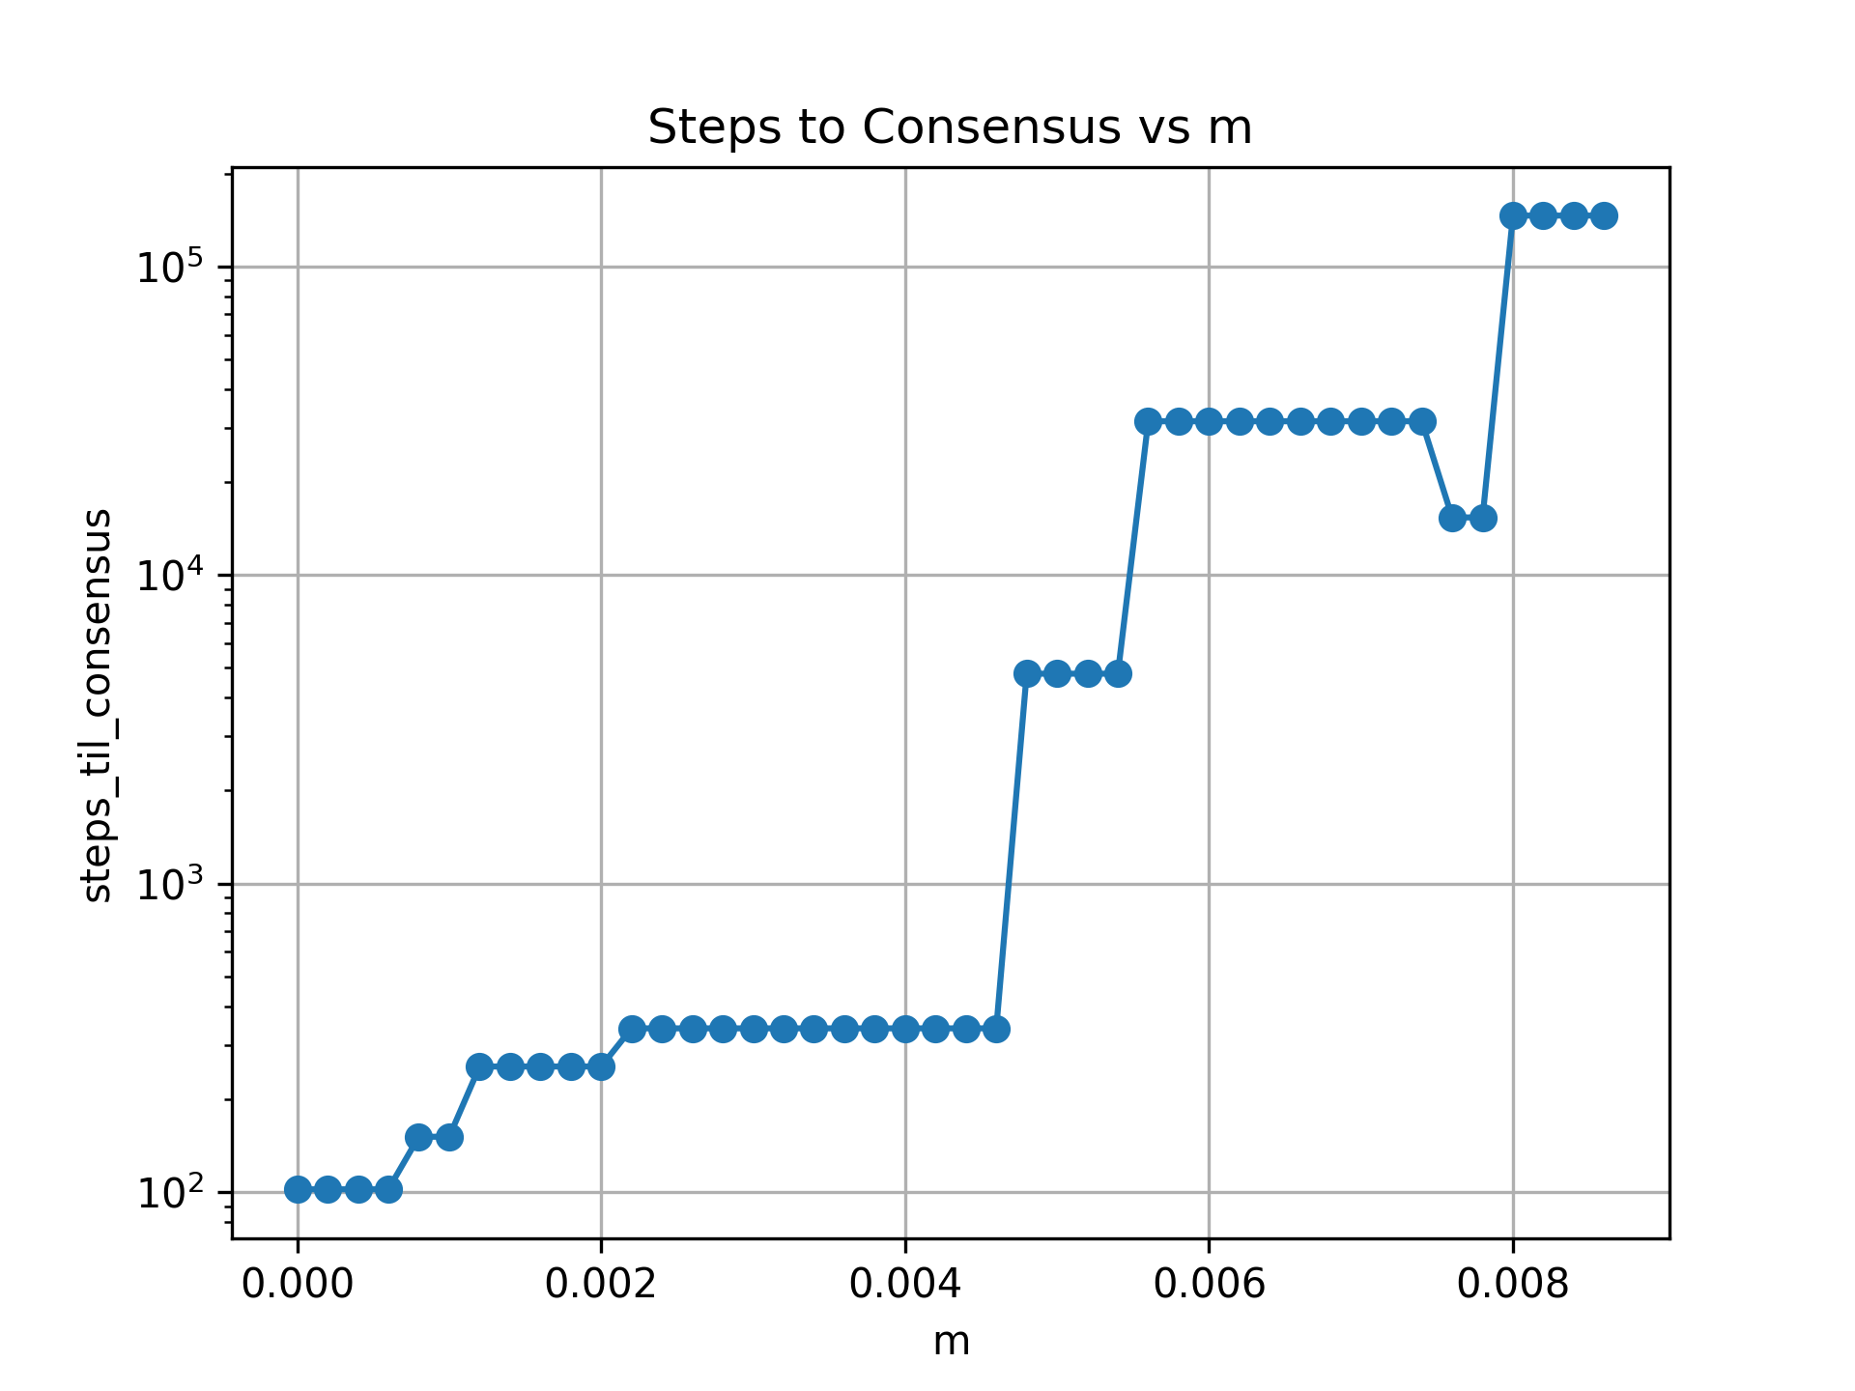
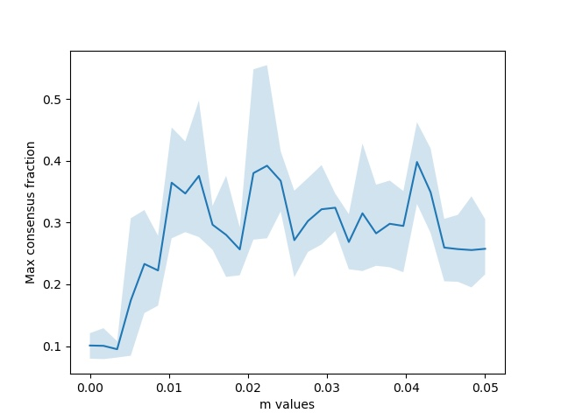
Results: Adding Mediators
How many mediator do we need?
The consensus size increases sharply with just a small increase in m (Mediator fraction)
The biggest gain comes from the first 1-2% of the population acting as mediators. You don't need everyone to be a peacemaker, just a critical few.

Slide 16
Society Types: Polarised vs Diplomatic
We simulated two distinct societal compositions.
The polarised society:
High fraction of Extremists (20%)
Zero Mediators.
2. The Diplomatic Society:
Low fraction of Extremists (5%)
Small fraction of Mediators (5%).
HYPOTHESIS: The Diplomatic society should sustain consensus at higher rewiring rates (higher "social stress")

Slide 17
Results: Stability Profile
The "Diplomatic" curve (Blue) stays higher than the "Polarized" curve (Red) most of the time as rewiring probability increases.
Conclustion: A small injection of mediators (5%) significantly improves the resilience of the entire network against fragmentation.
This answers one more hypothesis:
The Diplomatic society sustains consensus because mediators artificially maintain network connectivity (bridges) between opposing groups, allowing influence to propagate even when the majority of the population is trying to isolate themselves.

Slide 18
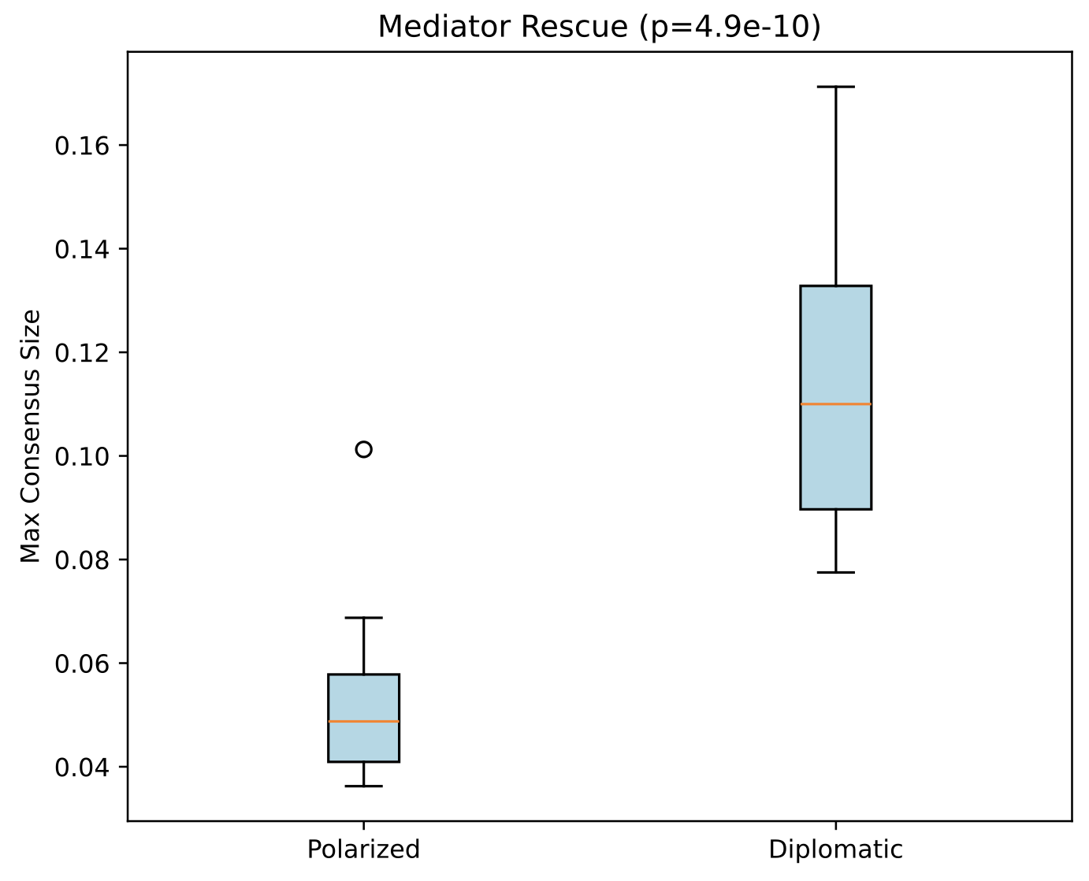
Statistical Analysis: The "Mediator Rescue" Effect
Question: Does introducing a small fraction of mediators (5%) actually make a significant difference in consensus, or is it just random noise?
We compared the Max Consensus Size (largest group agreeing) between two society types under identical stress ɸ=0.35
Results:
Polarized (Left): Consensus collapses. The median size is approximately 5% of the population. The society is effectively shattered.
Diplomatic (Right): Consensus is "rescued." The median size jumps to approximately 11%, with some trials reaching as high as 17%.
The p-value is virtually zero. This confirms that the improvement is not accidental; the presence of mediators creates a statistically significant, robust structural change in the network.
Conclusion:
Replacing a small number of extremists with mediators doesn't just "improve" the consensus linearly, it doubles or triples the size of the consensus group.
Mediators act as a firewall against total social fragmentation!

Slide 19
The "Humpty Dumpty" Effect (Hysteresis)
We ramped social stress (ɸ) up to break consensus, then ramped it back down to test for recovery.
Observation 1: The Polarized Trap (Red Line)
Forward: Society collapses abruptly at high stress.
Reverse: Irreversible damage. Even when stress is removed, consensus does not return (red dashed line stays flat).
Why? Extremists "burn bridges." The network physically disconnects into echo chambers, leaving no pathways for reintegration.
Observation 2: The Diplomatic Elasticity (Blue Line)
Forward: Declines but resists total collapse.
Reverse: Resilient recovery. The society heals as stress drops, returning close to its initial state.
Why? Mediators act as social elastic. They maintain thin "threads" of connectivity across the divide, allowing influence to flow back when the pressure releases.
Conclusion: Polarization creates a permanent topological scar on society, whereas mediators provide elasticity, making social fragmentation reversible.

Slide 20
Measuring Social Disorder: Complexity Analysis
We use Kolmogorov Complexity (via data compression) as a proxy for social entropy.
Low Complexity: High order, strong consensus (easy to compress).
High Complexity: High disorder, chaotic fragmentation (hard to compress).
Observation 1: The Polarized Collapse (Blue Line)
Complexity spikes immediately at low stress
Without mediators, the society experiences an immediate "information collapse," rapidly devolving into a disordered, unpredictable state.
Observation 2: The Diplomatic Buffer (Orange Line)
Complexity rises much slower, maintaining structural order even as stress increases.
Mediators act as entropy buffers. By maintaining cross group links, they preserve the structural integrity of the social graph, delaying the onset of chaos.
Conclusion: A diplomatic society is not just more connected, it is fundamentally more ordered and resilient to information decay.

Slide 21
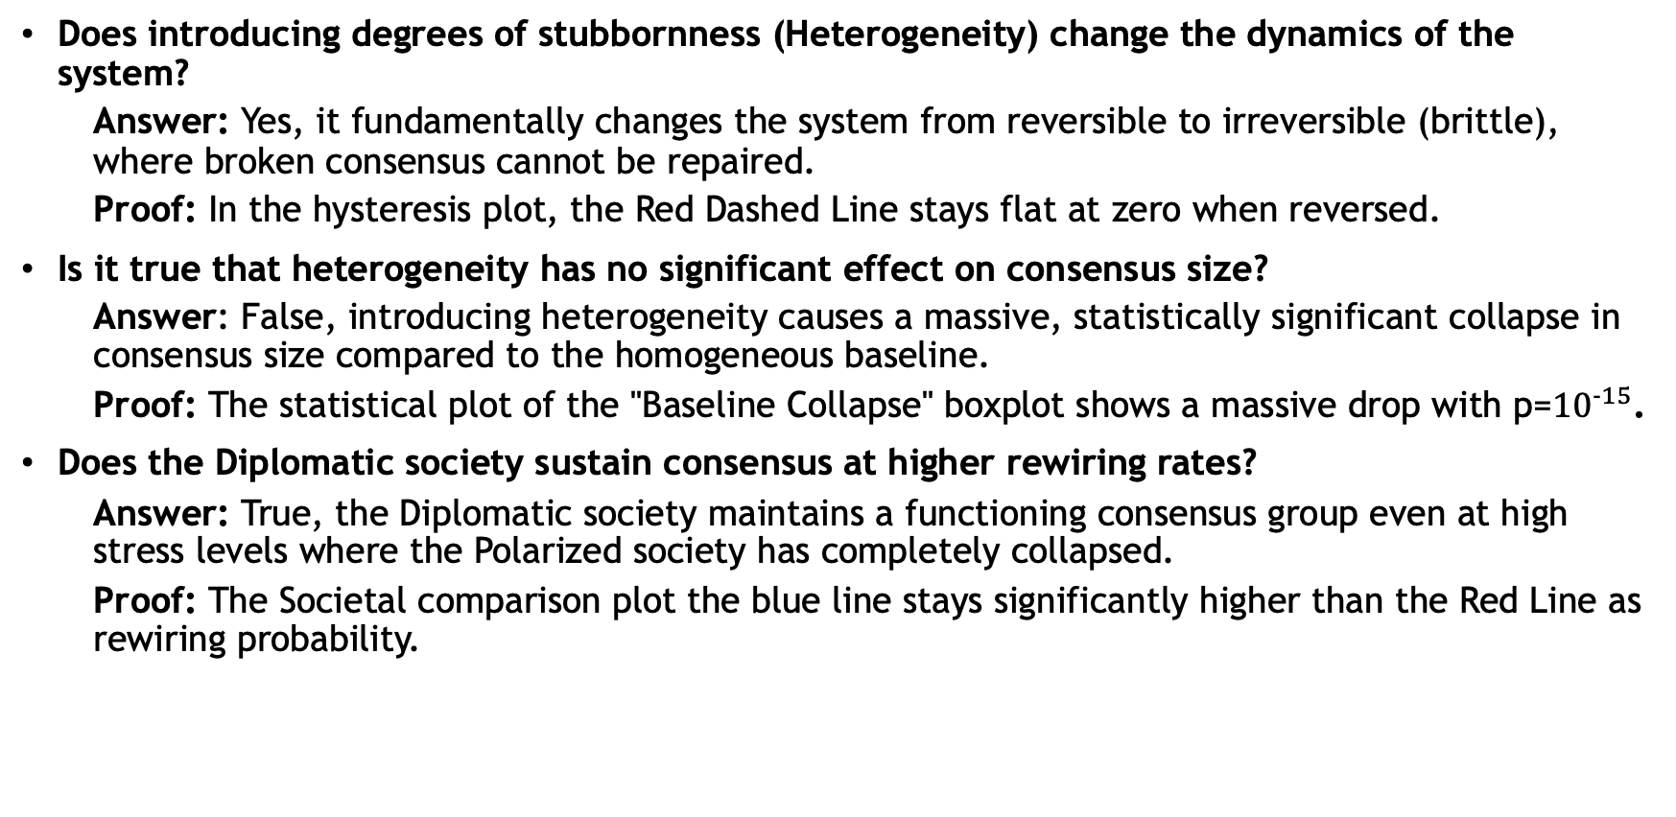
Research Questions?
Does introducing degrees of stubbornness (Heterogeneity) change the dynamics of the system?
Answer: Yes, it fundamentally changes the system from reversible to irreversible (brittle), where broken consensus cannot be repaired.
Proof: In the hysteresis plot, the Red Dashed Line stays flat at zero when reversed.
Is it true that heterogeneity has no significant effect on consensus size?
Answer: False, introducing heterogeneity causes a massive, statistically significant collapse in consensus size compared to the homogeneous baseline.
Proof: The statistical plot of the "Baseline Collapse" boxplot shows a massive drop with p=${10}^{-15}$.
Does the Diplomatic society sustain consensus at higher rewiring rates?
Answer: True, the Diplomatic society maintains a functioning consensus group even at high stress levels where the Polarized society has completely collapsed.
Proof: The Societal comparison plot the blue line stays significantly higher than the Red Line as rewiring probability.

Slide 22
Conclusion
Validated Social Physics:
We successfully replicated the Holme-Newman phase transition, confirming that social consensus depends on the balance between rewiring (echo chambers) and adoption (influence)
The Fragility of Polarization:
Introducing Extremists creates a "brittle" society. We observed Irreversible Hysteresis: Once a polarized society fractures, simply reducing stress fails to restore consensus because the structural bridges are gone.
The "Elasticity" of Diplomacy:
Mediators act as social glue. Even a small fraction (5%) changes the system's topology from brittle to elastic, allowing for recovery after fragmentation.
Final Takeaway:
Resilience against polarization does not require everyone to be open-minded. It requires a critical minority of mediators to maintain active "bridges" between opposing groups, preventing the formation of disconnected echo chambers.

Slide 23
Conclusion

